Slide 1
Project Week
UofT Data Bootcamp

Slide 2
Group – Pursuit of Happiness
Eben Haezer
J Kurt Baltero
Momotaz Mahin Khan
Sheri Shojaie
Vivi Santosa

Slide 3
Topic
Does money buy happiness?

Slide 4
Datasets
To update
Eben
Suicide rate - United Nations Development Program (CSV): link - WHO mortality data (API): link
Depression and satisfaction scores - World happiness score (CSV): link - National depressive score, Global Change Data Lab (CSV): link
Economic health - GDP - United Nations Development Program (CSV): link - Unemployment and poverty – The World Bank (CSV): link
Secondary data sets to explore / consider - Search term trends (API) - link - Geolocation (API) - link
JKurt
Momo
Sheri
Vivi
Vivi
Sheri
Sheri
Sheri
Momo
Vivi
Eben
Eben
JKurt
JKurt
Sheri
Notes:
Tourism: International arrivals as an indicator for tourism (https://data.worldbank.org/indicator/ST.INT.ARVL)
Sleep: https://www.1843magazine.com/data-graphic/what-the-numbers-say/which-countries-get-the-most-sleep
Fun: https://travelskills.com/2013/03/14/top-10-countries-that-have-the-most-fun/

Slide 5





questions:
To update
Question #1:
Is happiness score (amongst country of interest) changing over time ?
Question #2:
Indicators of happiness score: interesting variables that could be correlated with happiness: Variables to look at: Note: data must be in the following timeframe: 2015-2019
Crime rate; alcohol consumption; depression; population age; education; suicide rate; access to health care; wealth disparity; recreation/fun, pets, tourism, gambling/casinos, sleep/rest, culture, religion
Question #3:
Why are people in certain rich countries (by GDP) less happy?
And why are people in certain poor countries (by GDP) more happy?
BONUS / next project: (search terms)
For a select country of interest (e.g. Canada), is happiness score correlated to Google Trend search? Are Indicators of World Happiness Report (Economy, Family, Health/ Life Expectancy, Freedom)
correlated to Google Trend search interests - ‘recession’, ‘divorce’, ‘death’, ‘protest’…?

Slide 6
Does money buy you happiness?

Slide 7
Why is looking at happiness important?

Slide 8
Data background:
Source
Number of years
2007 – 2019
Scores are relatively stable (variation?)
Focused on most recent complete year: 2017
Our focus and questions

Slide 9
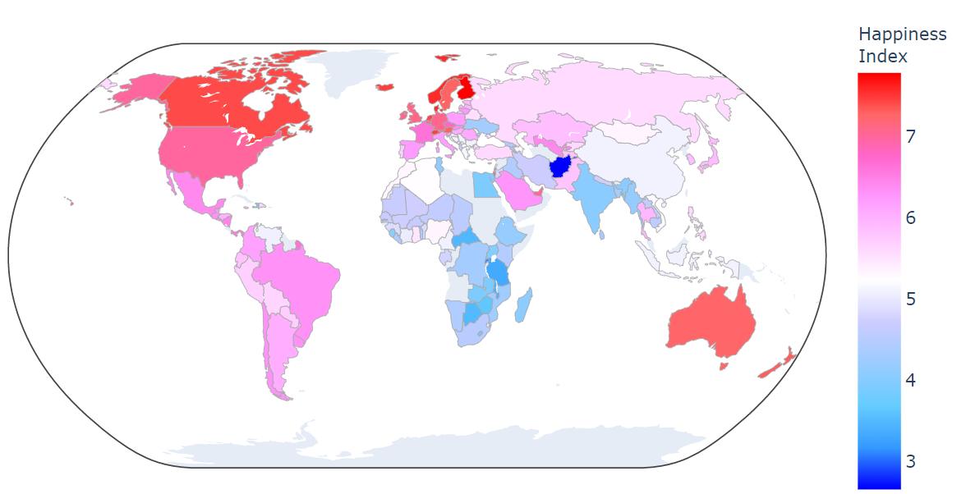
Question 1
Show happiness index across the globe

Slide 11
What impact happiness? Does economic health impact the level of happiness?
H₀ = Economic health is not related to happiness
Intro to economic health variables:
GDP (maybe also median annual wage)
Unemployment

Slide 12
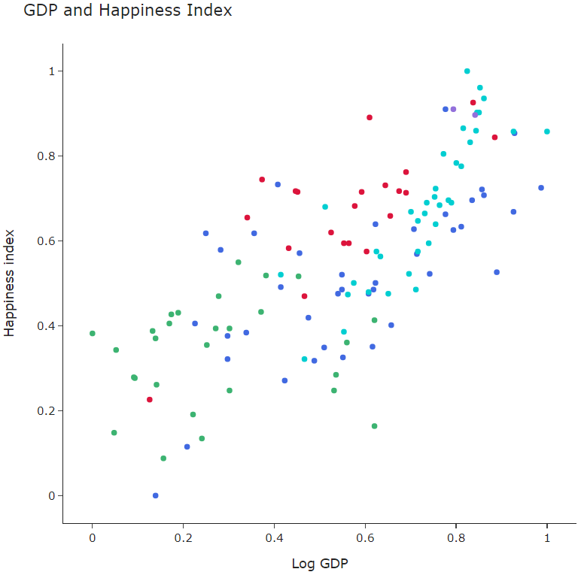
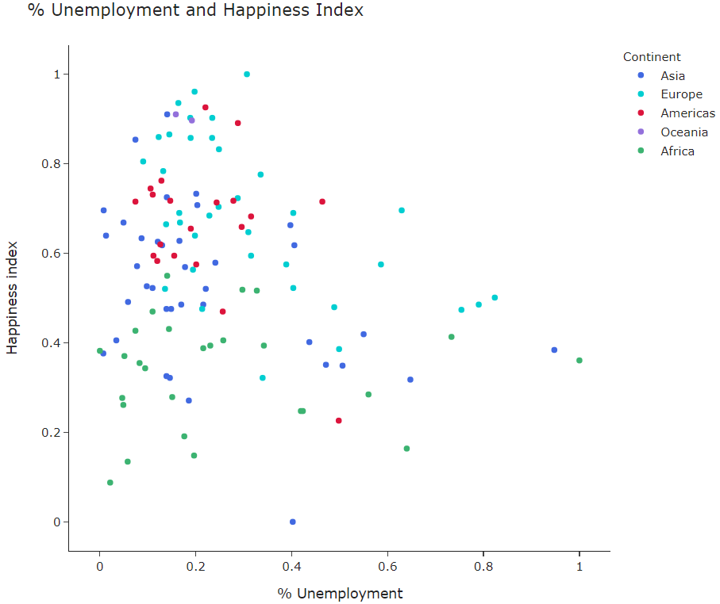
Question 2
Economic health and happiness index correlation (and outliers!)

Slide 13
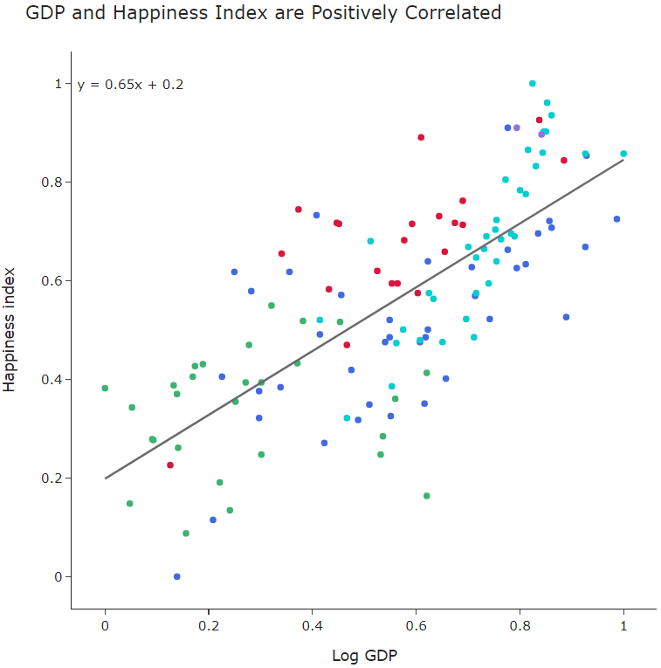
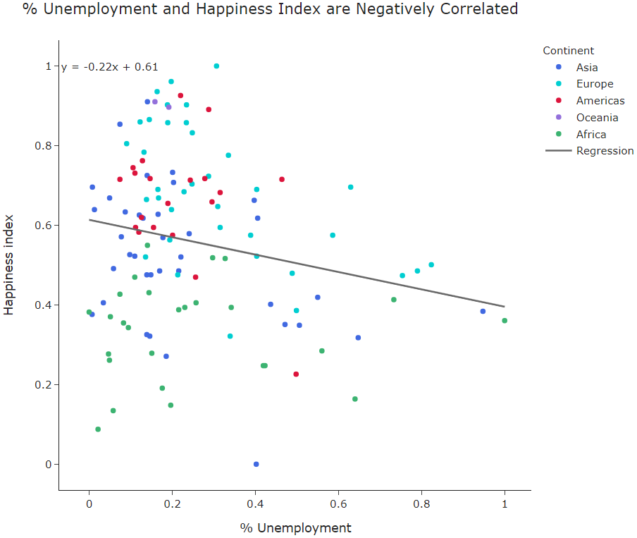
Question 3
Economic health and happiness index correlation (and outliers!)
Costa Rica
Nicaragua
Brazil
Spain

Slide 14
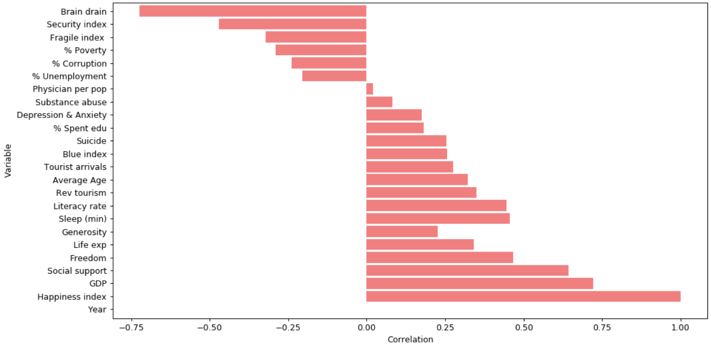
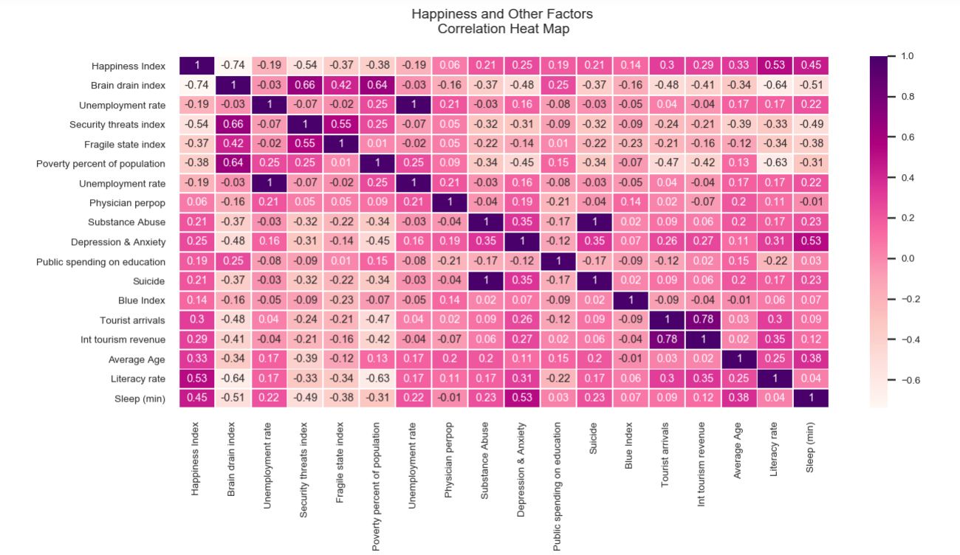
Question 4
What else makes people happy?
We looked at 23 variables (6 are from the index)
Negatively Correlated
Factors
Positively Correlated
Factors
Variables from the Happiness Index

Slide 15
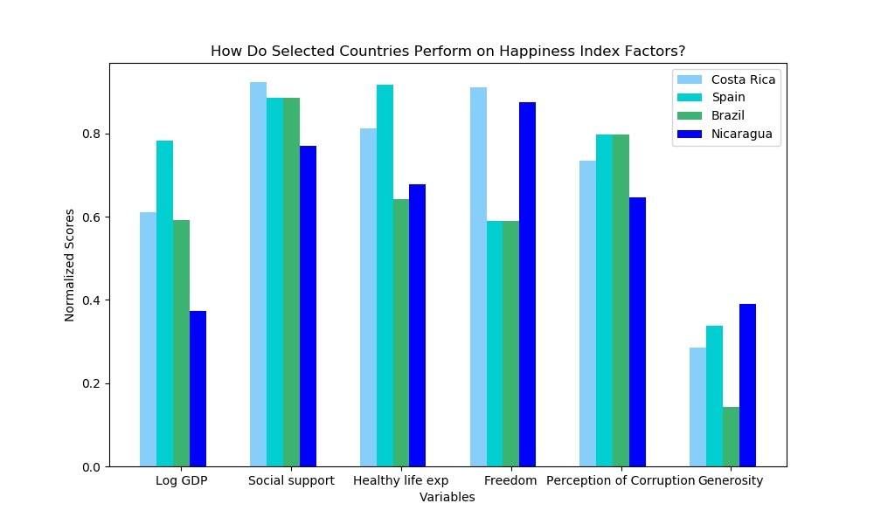
Question 5
How do our outliers look on these happiness variables?
Variables: (we need to pick 3-5 that are interesting)

Slide 16
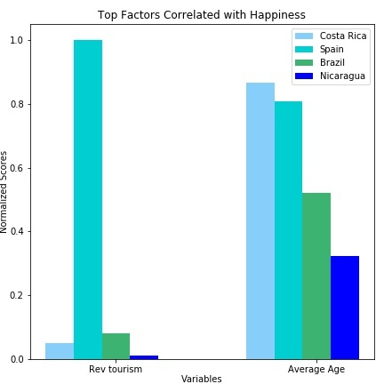
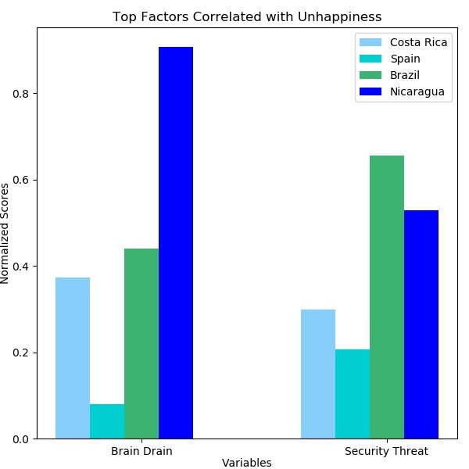
Question 5
How do our outliers look on these happiness variables?
Variables: (we need to pick 3-5 that are interesting)
Outlier countries

Slide 17
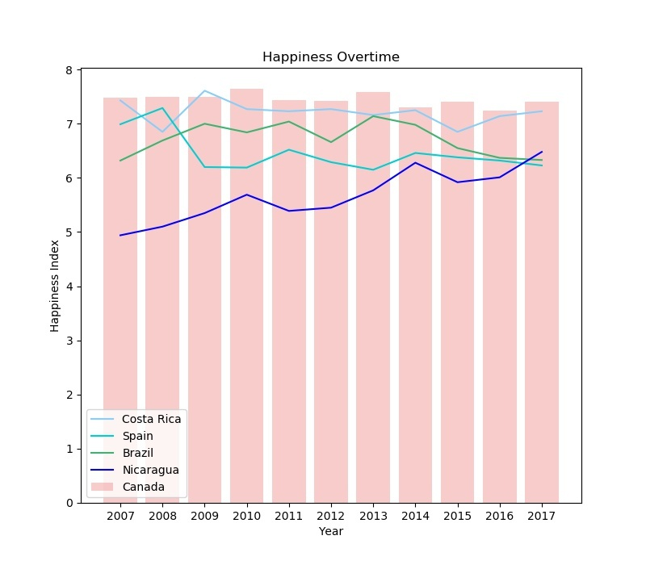
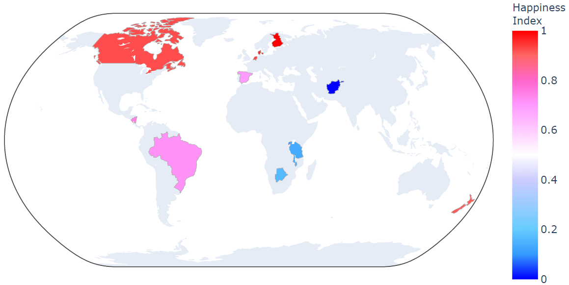
Question 7
How does Canada compare?

Slide 18
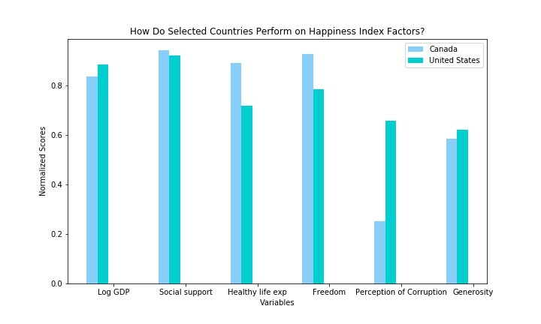
Canada
US

Slide 19
Conclusion: money doesn’t necessarily buy happiness, but it helps

Slide 21
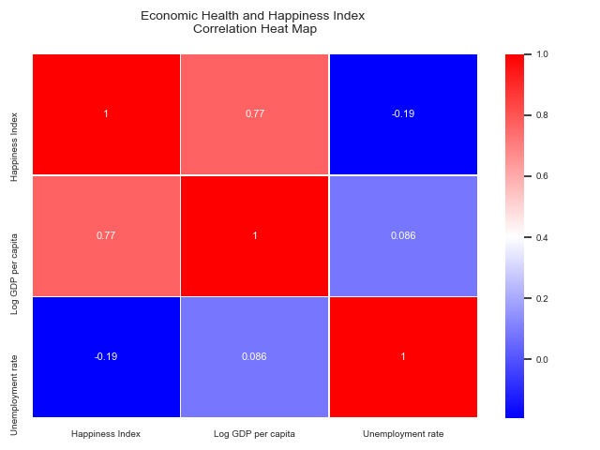

Slide 22
